Slide 1

TypeScript

Slide 2
Contents
Overview
Config overview
Type system
Custom types
Union & intersection Types
Modifyers
Type guardians
Tuples
Enums
Abstract classes
Generics
Built-in types

Slide 4
Overview
JavaScript that scales
Starts and ends with JavaScript
Strong tools for large apps
State of the art JavaScript
Developed by Microsoft. First release - end of 2012(October)
Conceptually - JS is a valid TS
Current version – 3.8

Slide 5


Slide 6
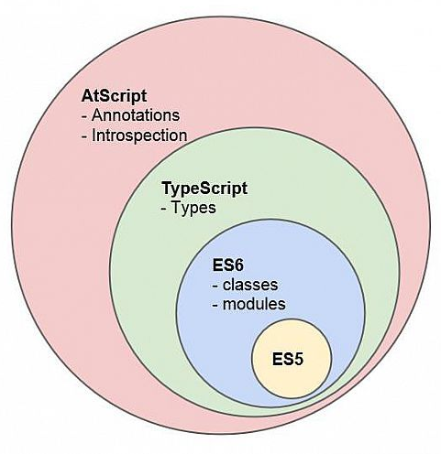
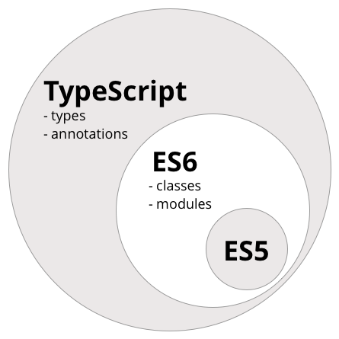
Typescript is Superset

Slide 7
Starter pack
Install typescript as dev dependency
npm I typescript –D
Install typings for nodejs
npm I @types/node
Init config
(npx) tsc --init

Slide 8

Demo

Slide 9
Type system
number
string
boolean
object
T[] or Array<T> (where T – number, string, etc.)
undefined
void (same as undefined, but used for methods)
any(any type – we don’t know what is type. Never use any. Exception – porting JS lib)
unknown(as any – but with type checking. ‘strict any’)
Never – used for unreachable code, such as exceptions
Custom types – used for combine one or more types

Slide 10
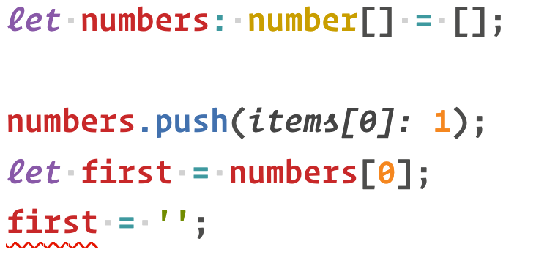
Arrays. Why error?

Slide 11
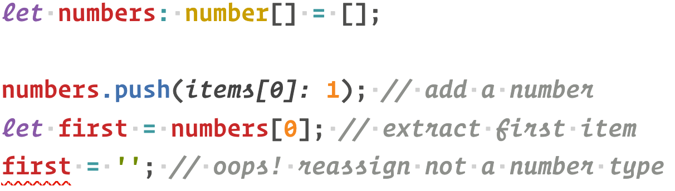
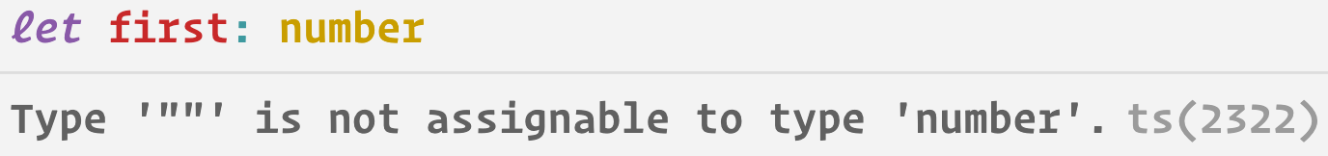
Arrays

Slide 12
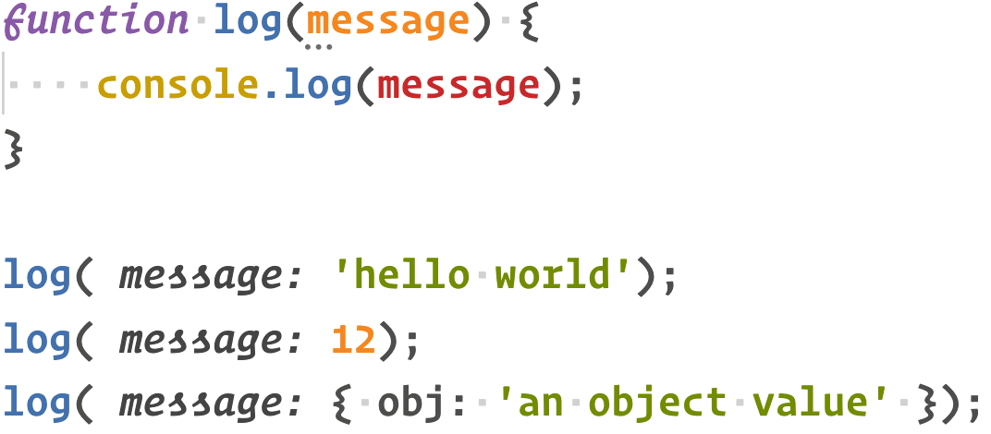
void

Slide 13
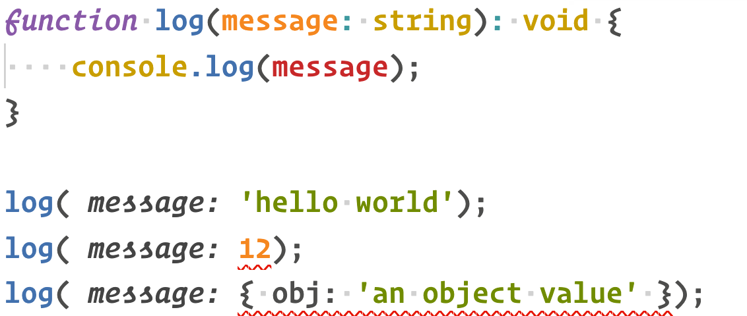
Void

Slide 14
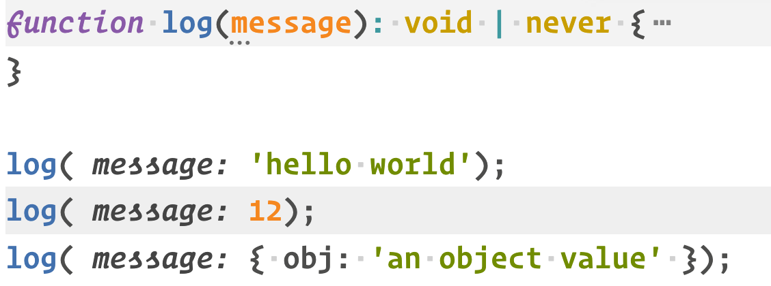
Never

Slide 15
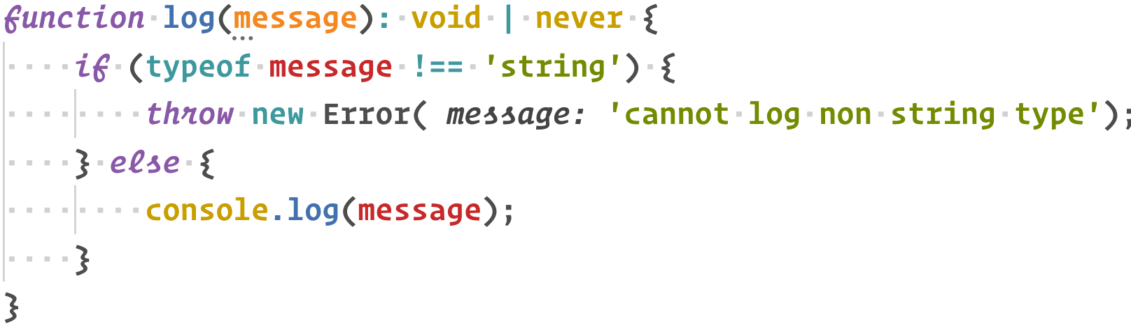
Throwing an error

Slide 16
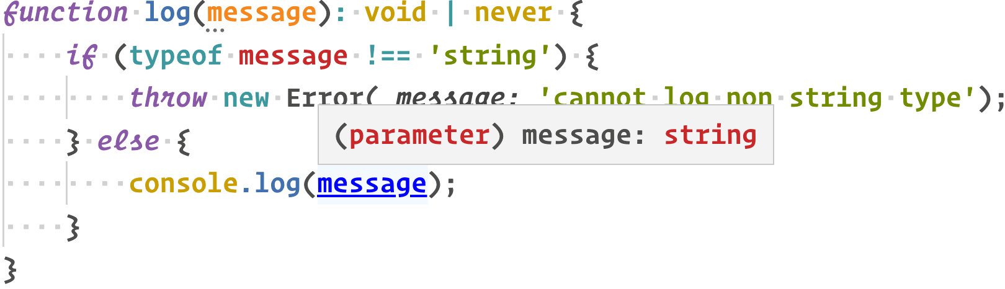
Autodetecting type

Slide 17
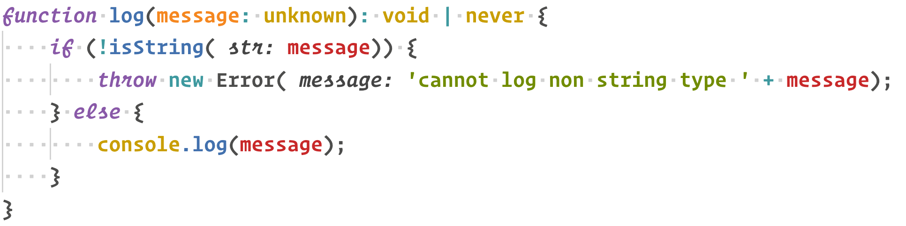

Slide 18
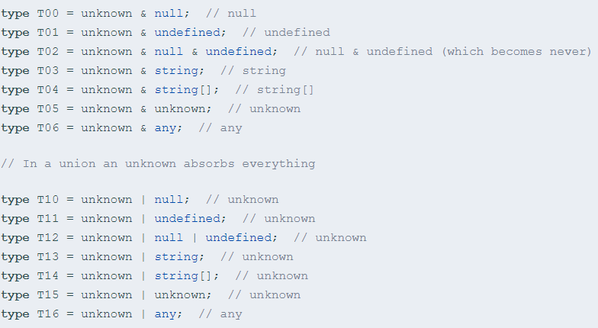
unknown

Slide 19
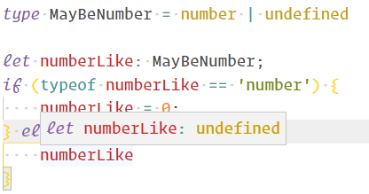
Custom type

Slide 20
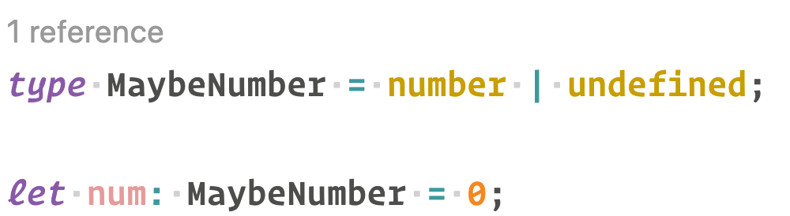
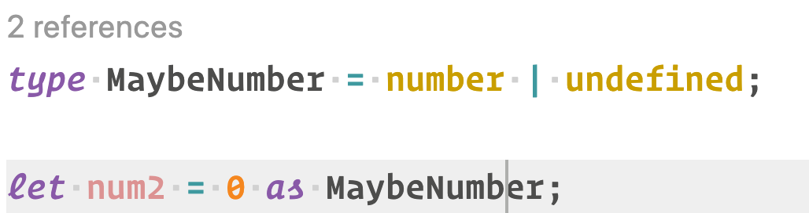
Type casting

Slide 21
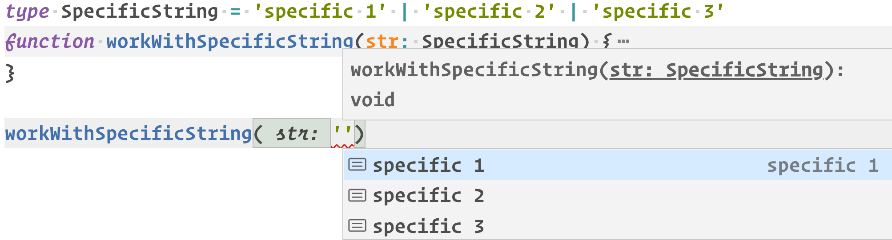
String typing

Slide 22
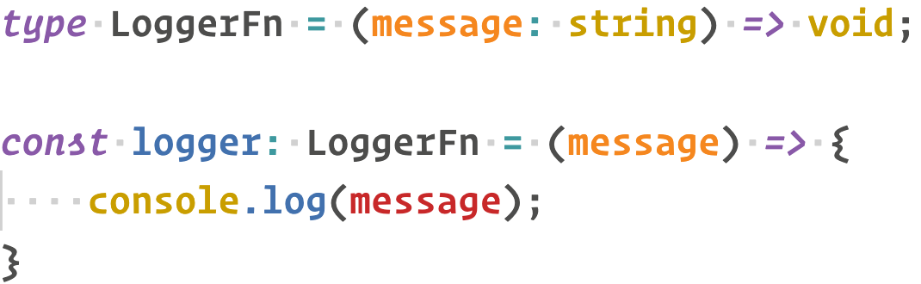
Custom function type

Slide 23
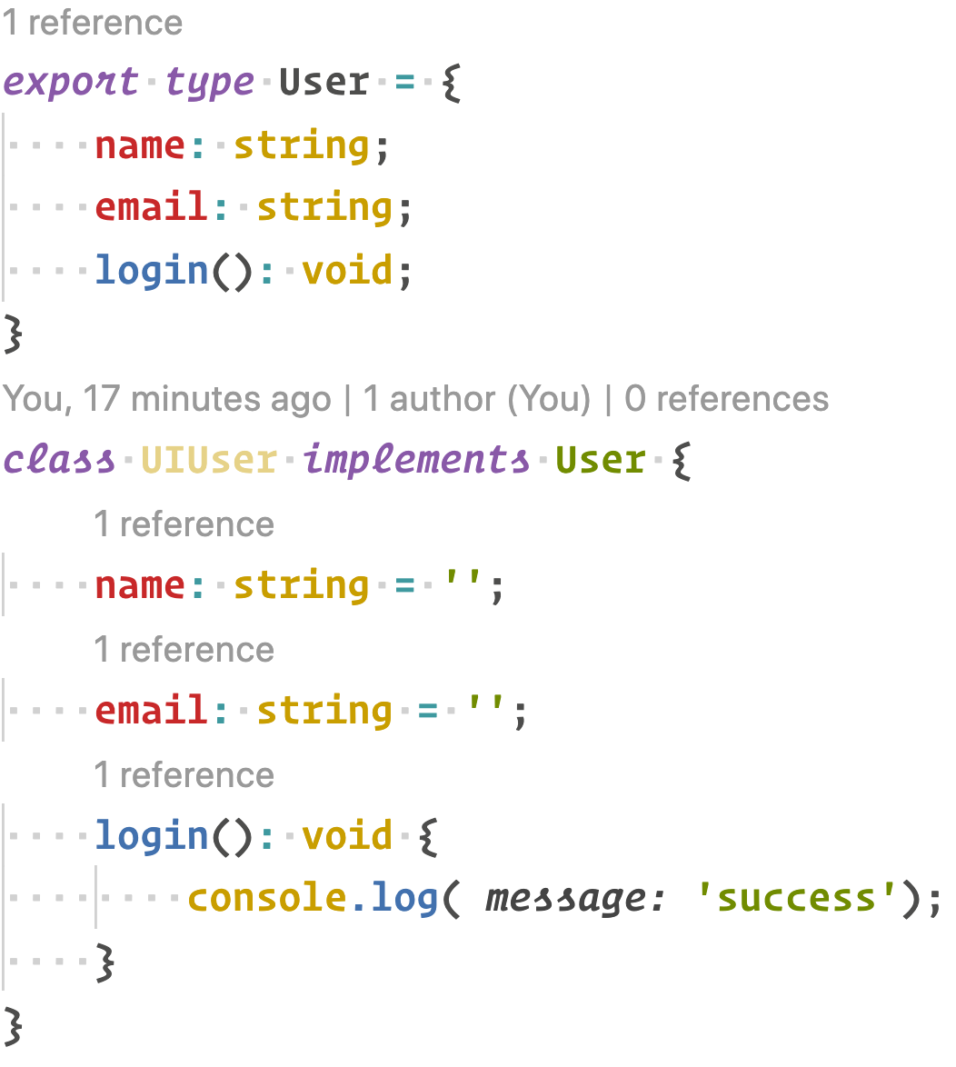
Implementing types

Slide 24
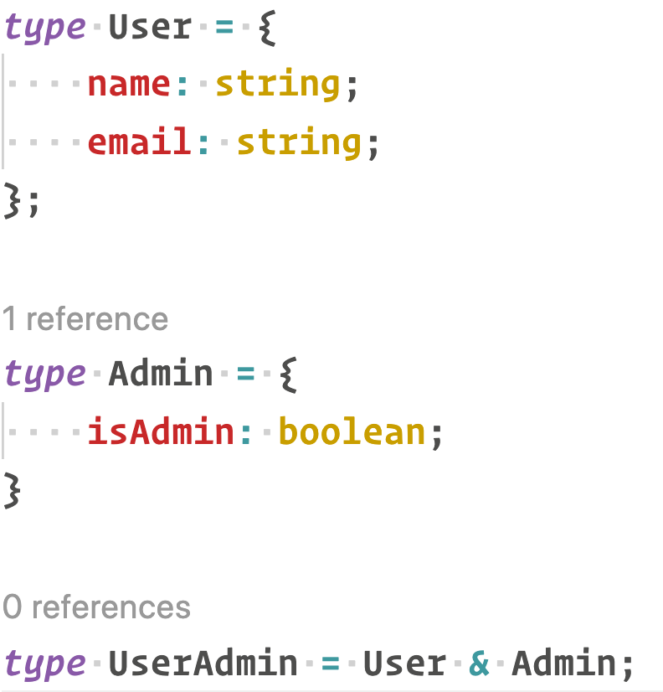
Union type

Slide 25
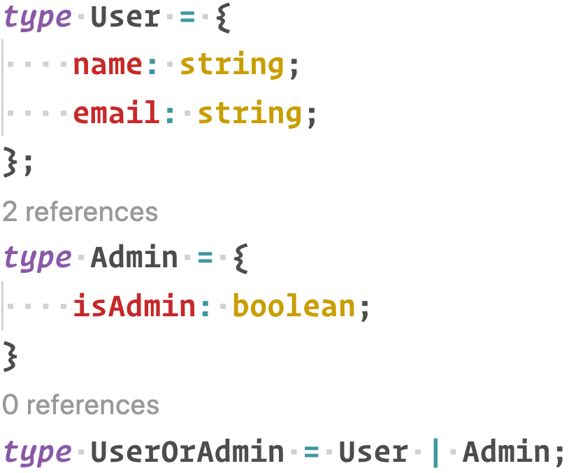
Intersection type

Slide 26
Modifyers
public (implicit)
private
protected - private for subclass
readonly – like const, but allow first-time initialization(if in class – allow init in constructor)

Slide 27
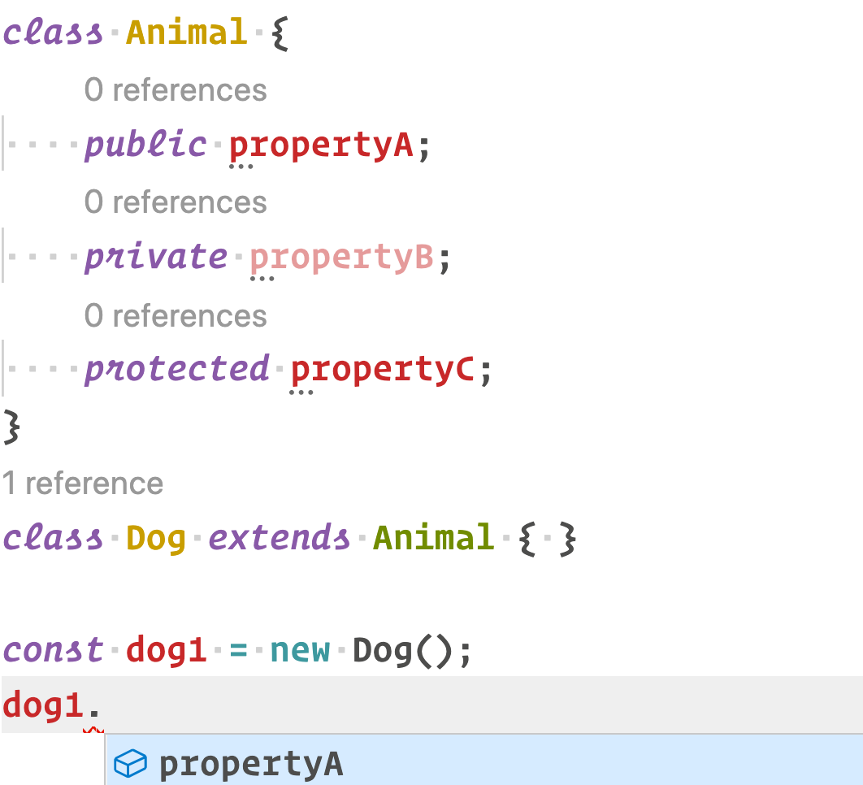
public

Slide 28
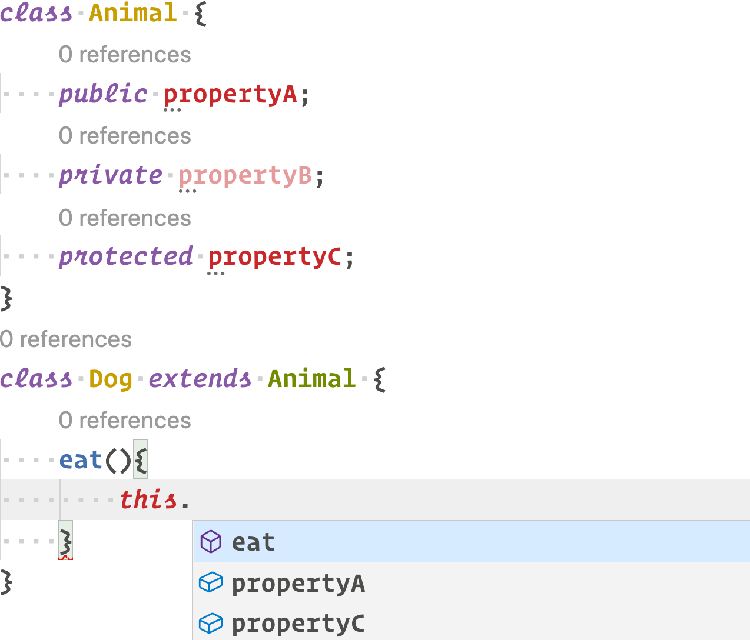
protected

Slide 29
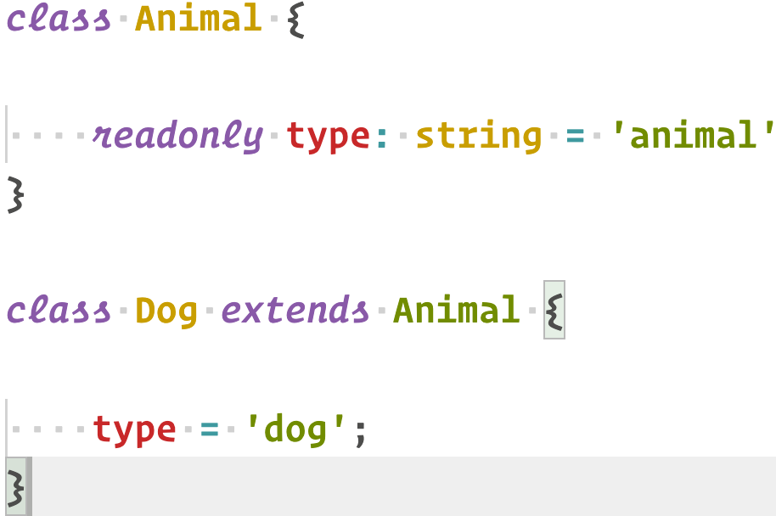
readonly

Slide 30
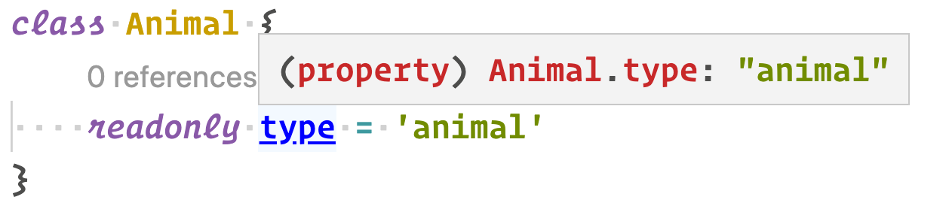
caveats

Slide 31
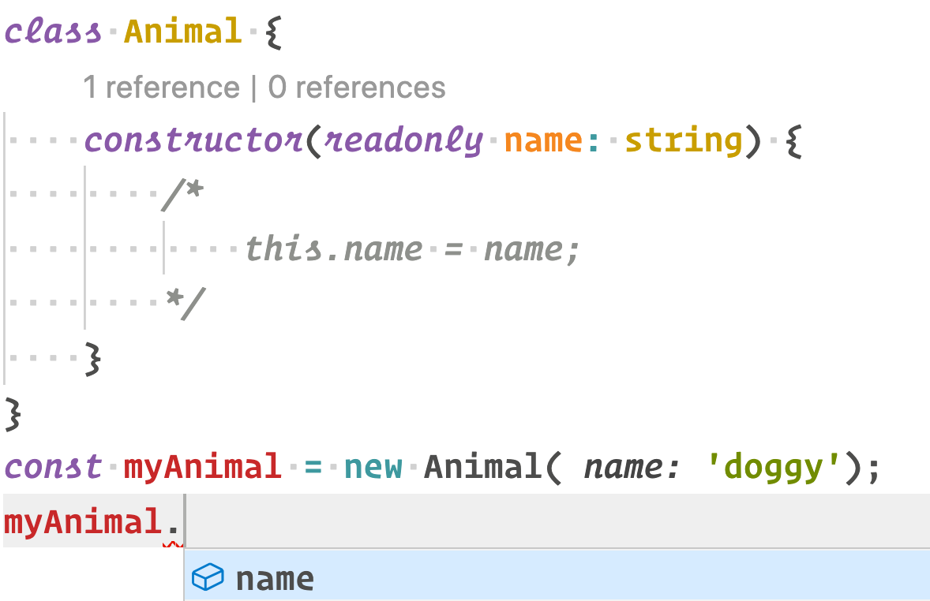
Bonus. Autofill input

Slide 32
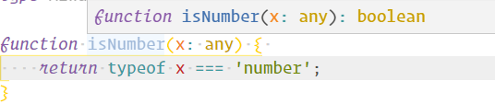
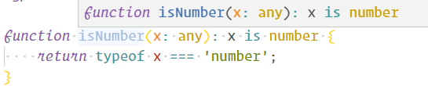
Function guard

Slide 33
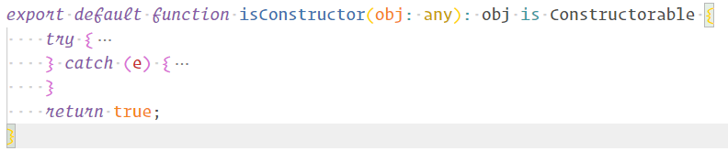
Real life example

Slide 34
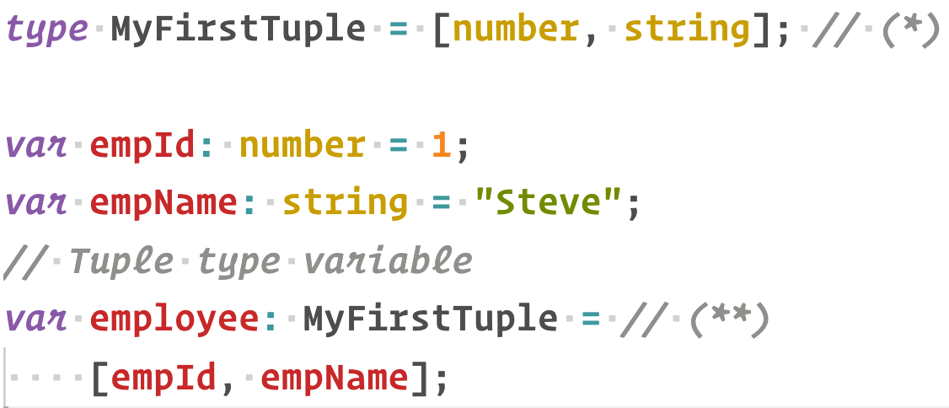
Tuple

Slide 35
Tuple array

Slide 36
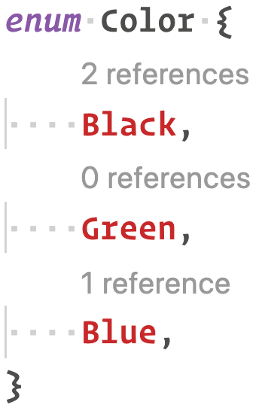
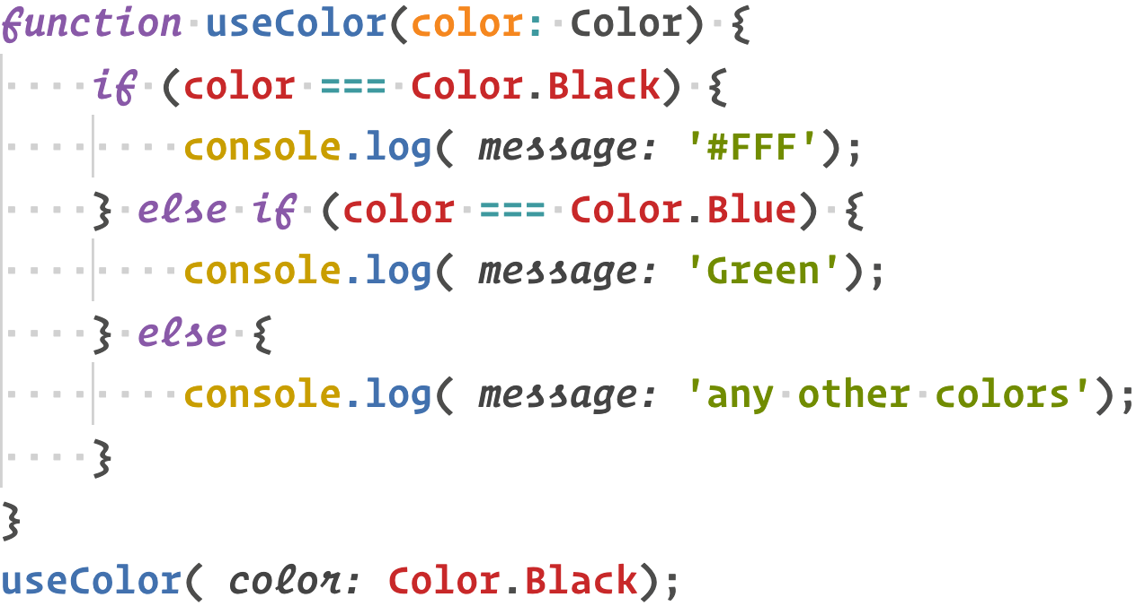
Enum

Slide 37
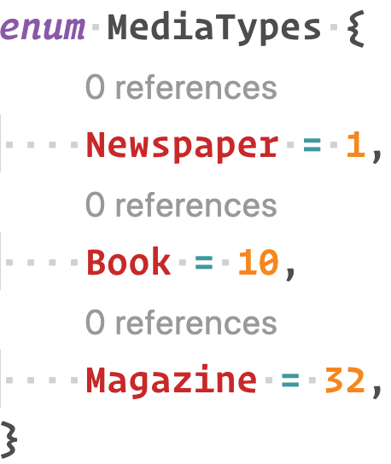
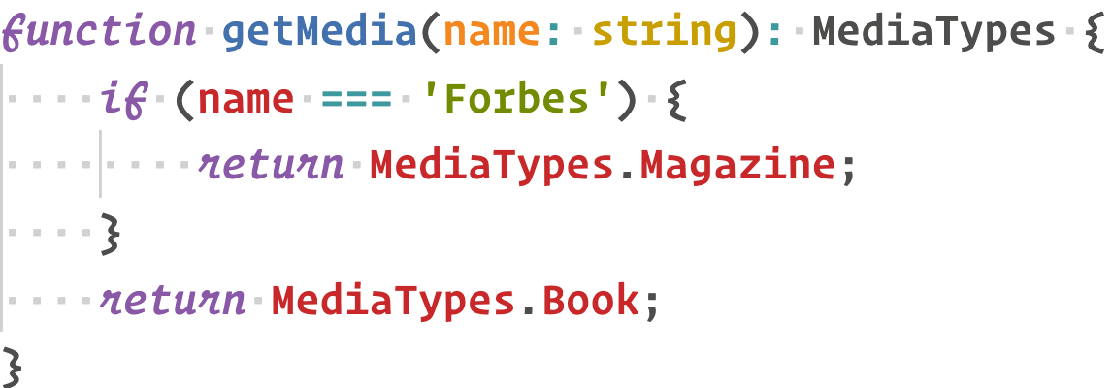
Enum as return type

Slide 38
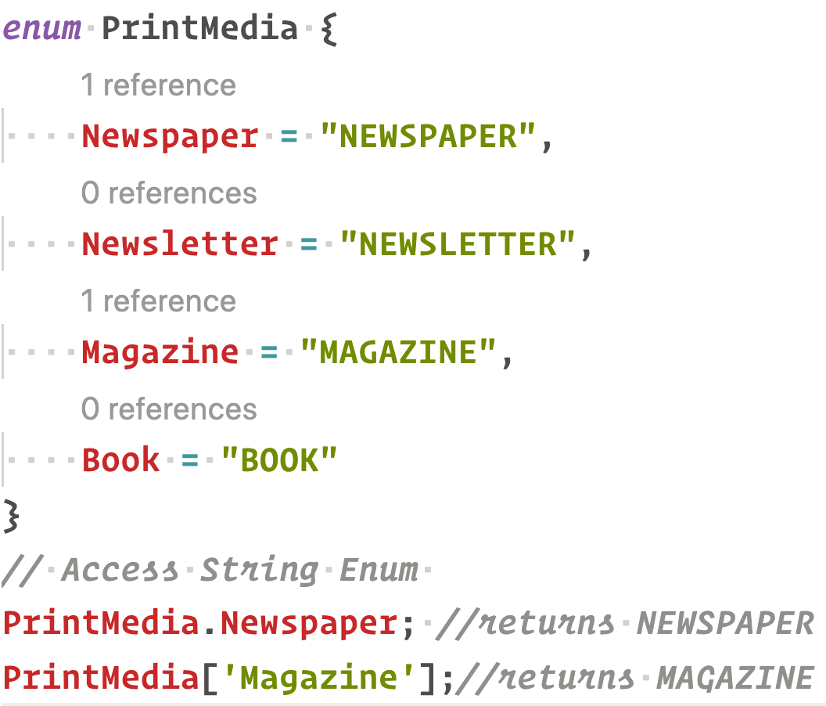
String enum

Slide 39
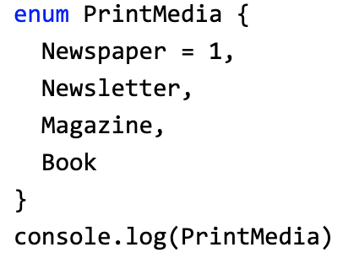
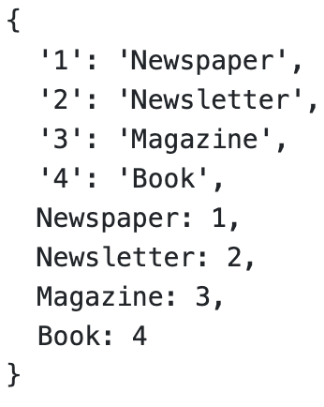
Enum is an object

Slide 40
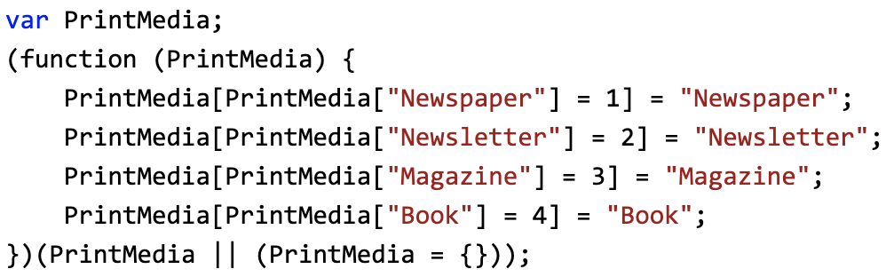
How enum compiles

Slide 41
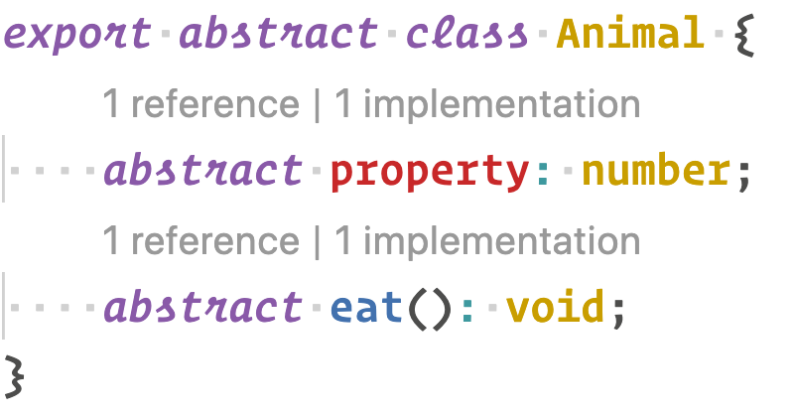
Abstract class
Abstract class – class that cannot be called with ‘new’ keyword

Slide 42
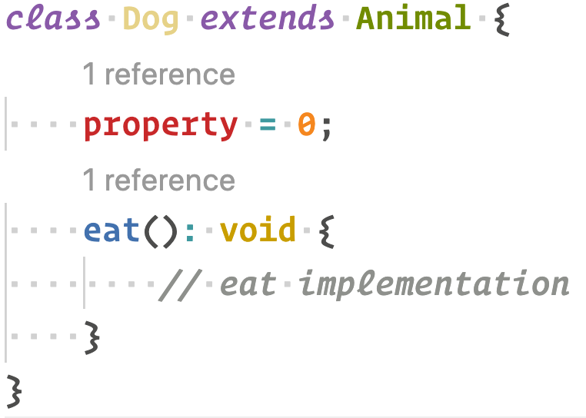
Implementing or extending

Slide 43
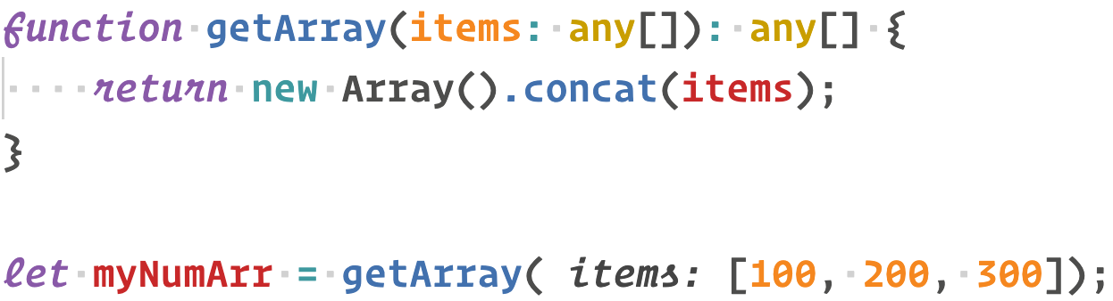
Generics
Generics offer a way to create reusable components
Generics provide a way to make components work with any data type and not restrict to one data type

Slide 44
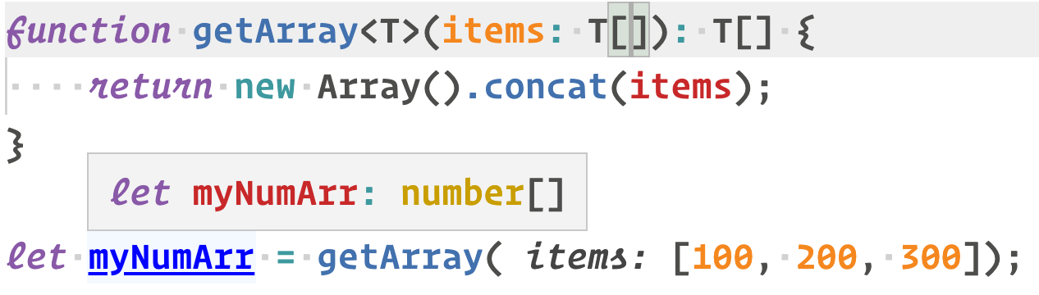
Generic example
Creating generic and put type as input parameter
No any
autocomplete works well

Slide 45
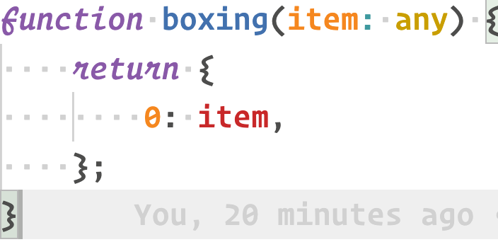
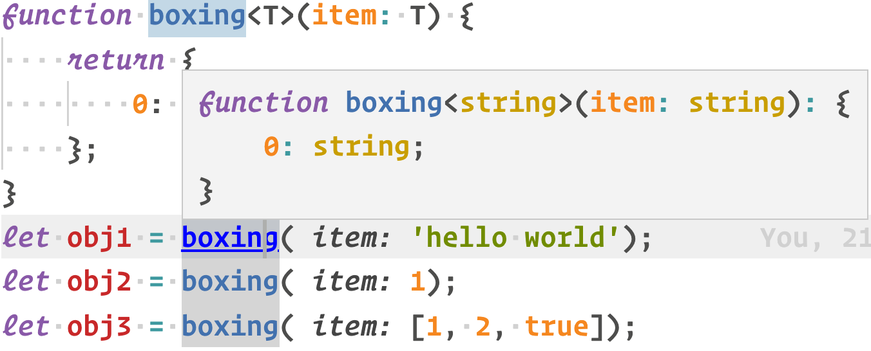

Slide 46
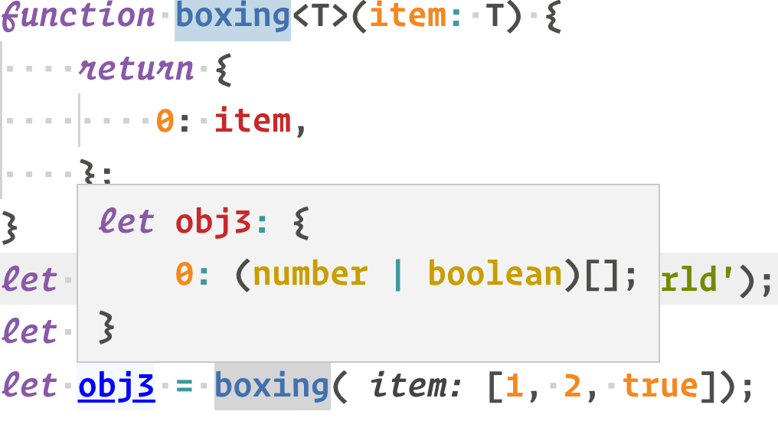

Slide 47
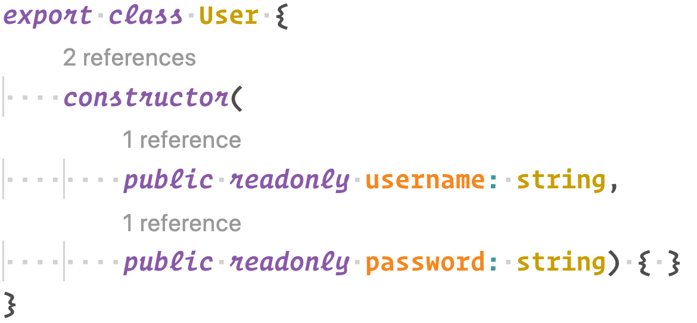
Generic constraints

Slide 48
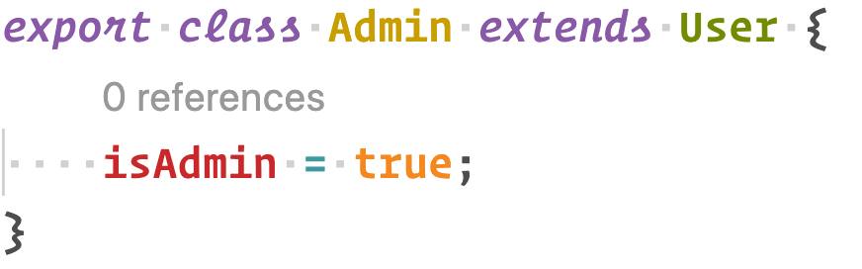
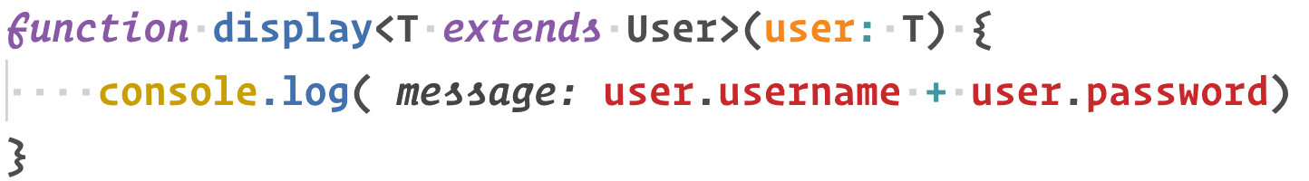
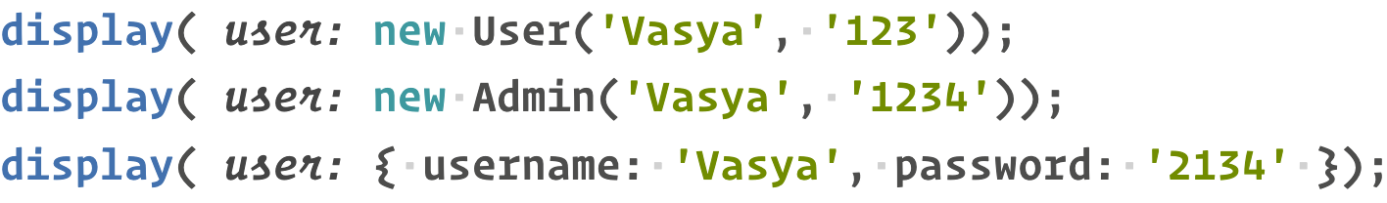

Slide 49
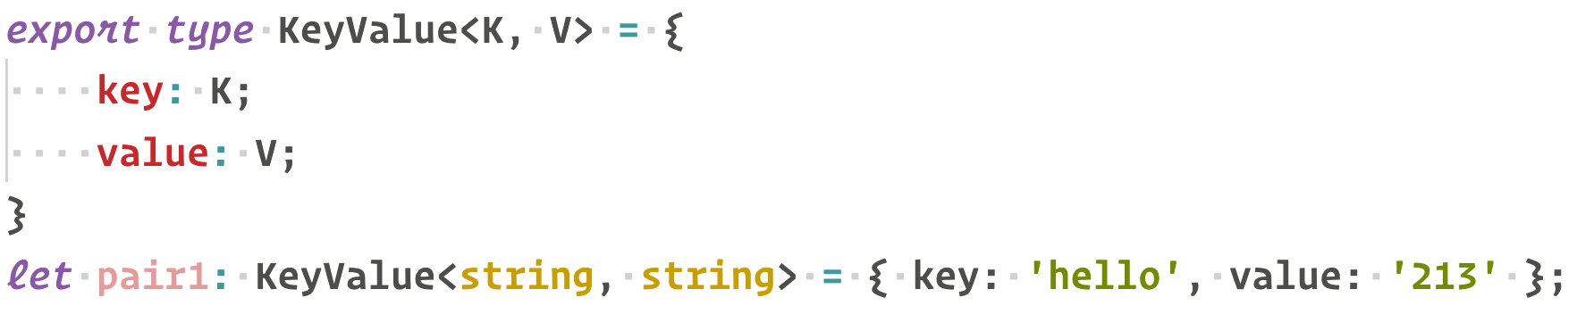
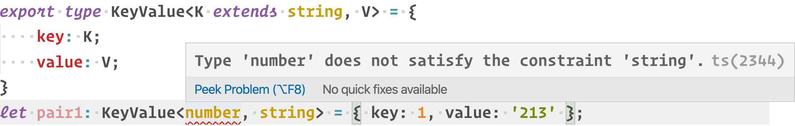
Generic types

Slide 50

Generic classes

Slide 51

typeof

Slide 52


keyof

Slide 53
Built-in types
Partial – make all props optional
Required – all props required
Readonly – all props readonly
Pick – from obj take value
Record – obj-like
Exclude – exclude from obj
Extract – extract subtype
Omit – obj without prop
NonNullable – exclude null fields
Parameters – get Fn parameters dynamicly
ConstructorParameters – get Ctor parameters dynamicly
ReturnType – get Fn return type dynamicly
InstanceType – get Ctor instance dynamicly

Slide 54
3-rd party libraries
Installing typescript and nodejs typeings for autocomplete
Npm I typescript @types/node ts-node –D
Not all libs have native typescript integrations – to solve this issue use @types repository
Npm I @types/<package-name>
Npm I @types/node
Npm I @types/jquery

Slide 55
Homework
Implement music library with albums, artists & tracks.
Each track should have an artist(s)(like ‘artist_1 feat. artist_2’)
Each track should have duration time
Each track should have explicit mark or not
Album should have release time
Each artist have list of albums
Each album should have tracks
Implement one search function, it allows to search by artist and album and track.
Search function should return a promise with result
Library should support CRUD operations with albums, artists and tracks
Library should support shuffle mode
Library should be one instance for one client
playable/pausable/next/prev/list commands
use SOLID, DRY, etc. principles
Type guardians for duration, artist, track, album
‘any’ type is banned.
If usable 3-rd party lib not have types – need to add types.
Use at least 1 generics type
Use code quality tools(prettier, husky, commitlint, eslint)
package.json should have at least “start” and “build” commands
BONUS: Add unit tests at least for albums, tracks, artists, library
BONUS: implement console UI.
BONUS: add keyboard shortcuts
BONUS: I can hear playable tracks

Slide 56
Self study
Infer
Enum constants
Recurse types
Interfaces and types
Typeof and keyof
Library typings
https://www.credera.com/blog/technology-solutions/typescript-adding-custom-type-definitions-for-existing-libraries/
https://medium.com/@steveruiz/using-a-javascript-library-without-type-declarations-in-a-typescript-project-3643490015f3
https://medium.com/@chris_72272/migrating-to-typescript-write-a-declaration-file-for-a-third-party-npm-module-b1f75808ed2

Slide 57
References
Presentation examples
https://github.com/magiqans/JS-Training/tree/master/09-typescript
Typescript official site
https://www.typescriptlang.org/
https://www.typescriptlang.org/docs/handbook/advanced-types.html
Tutorial teacher
https://www.tutorialsteacher.com/typescript/typescript-generic

